Slide 1
Survival Analysis III
Content prepared by Joris Menten

Slide 2
Overview
Part III:
  advanced topics
    Checking the proportional hazards assumption
    Informative censoring
    Interval censoring
    Sample size calculations

Slide 3
Advanced topics
How to check proportional hazards assumption?
  if KM curves cross: not proportional hazards
  otherwise:
    sometimes evident: if treatment difference suddenly increases/decreases ⇒ not proportional hazards
    in general hard to check:
      some programs can test proportional hazards assumption or plot the estimated hazard ratio over time
      calculate the relative risks over a number of periods of equal length: if relative risks vary strongly, the proportional hazards assumption may be violated

Slide 4
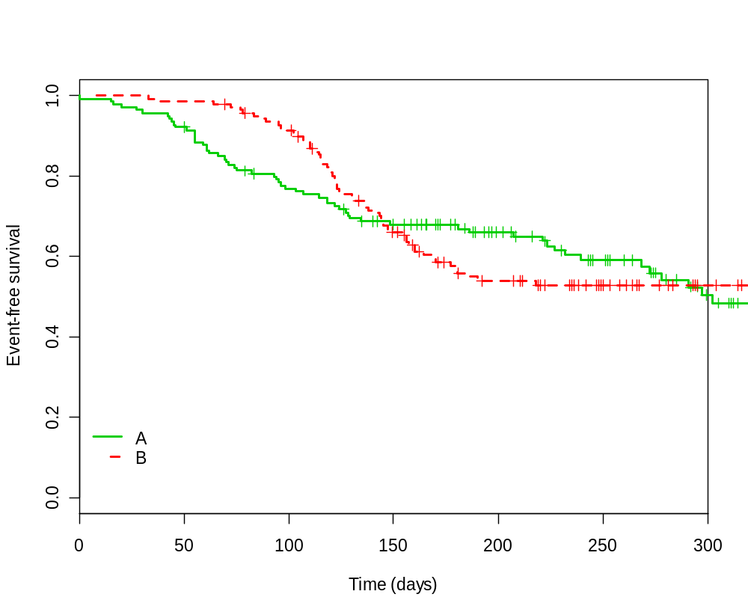
Proportional hazards?

Slide 5
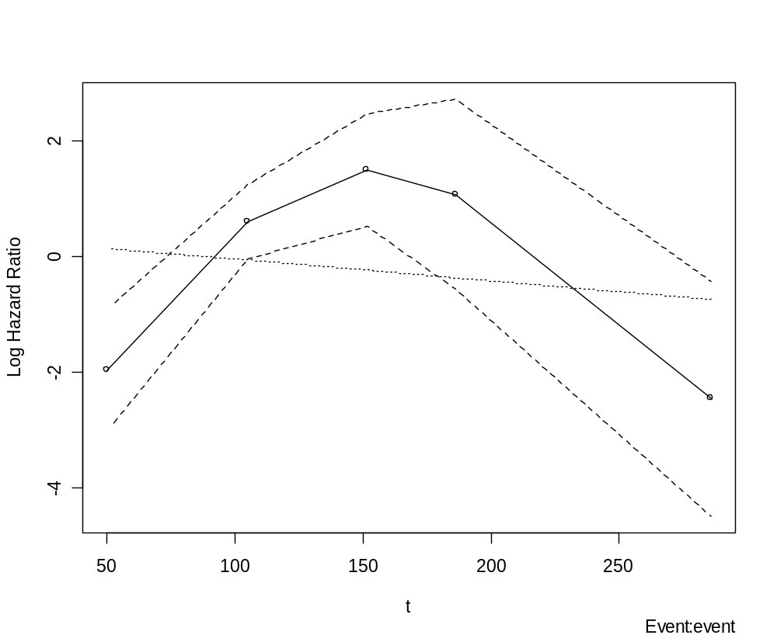
Note: if HR < 1 then log(HR)<0, if HR = 1 then log(HR)=0, if HR>1 then log(HR)>0

Slide 6
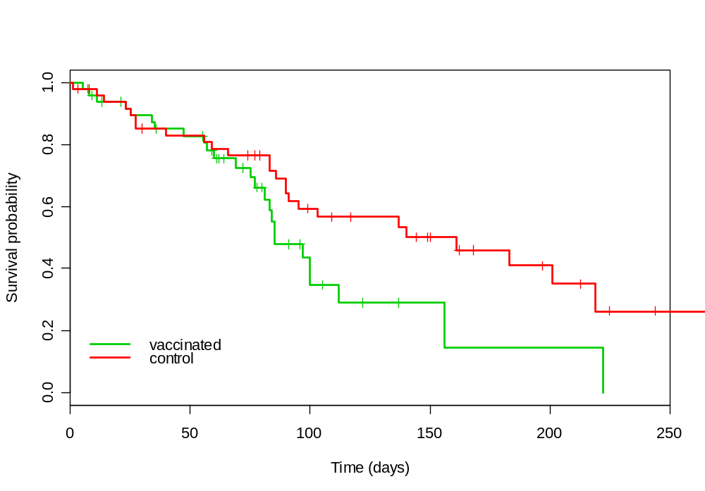
Proportional hazards?

Slide 7
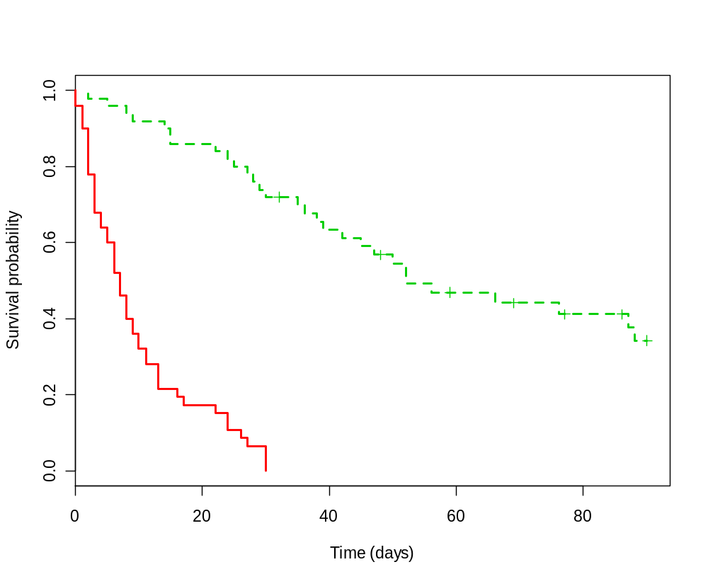
Proportional hazards?

Slide 8
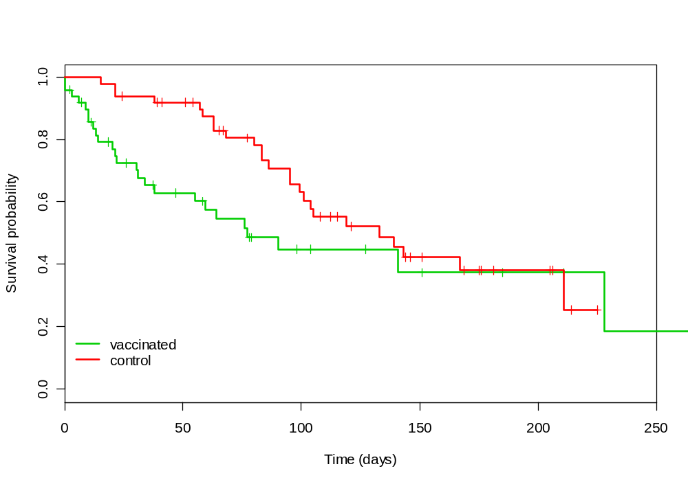
Proportional hazards?

Slide 9
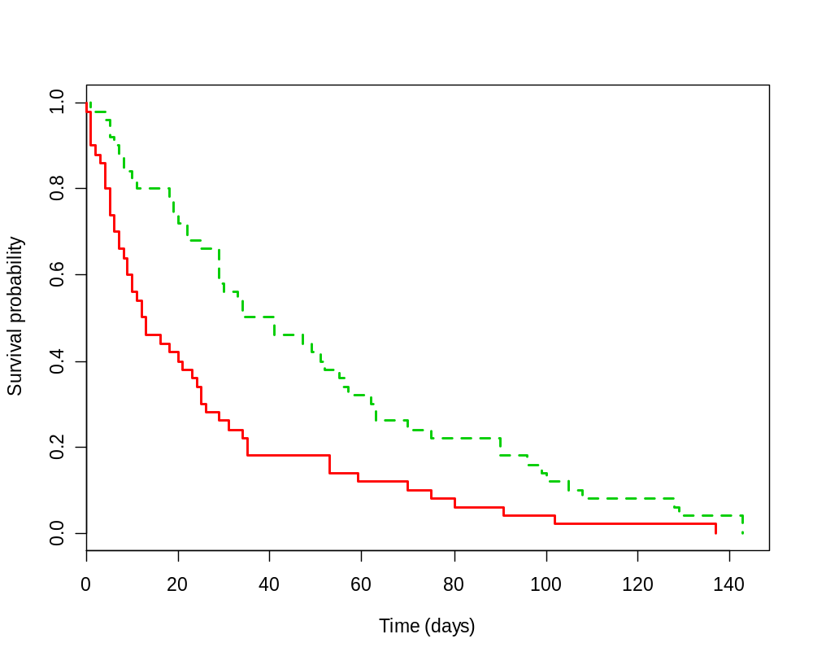
Proportional hazards?

Slide 10
Informative censoring
Remember assumption: survival time is independent of censoring:
survival time of patients that are censored at a certain timepoint
=
survival time of patients that remain in the study
If violated: informative censoring
  bias in estimating survival probabilities
  possibly bias in testing predictors of survival
    if censoring differs between groups

Slide 11
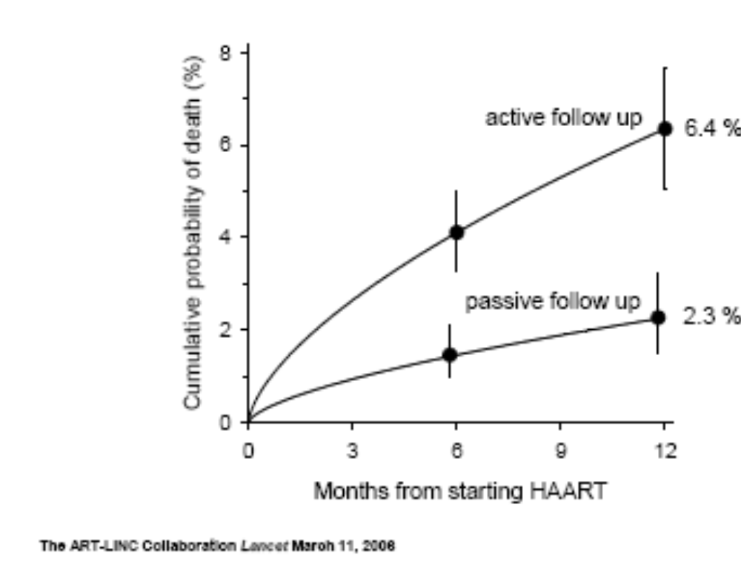
Bias due to informative censoring
First year mortality in ARV programs in low-income countries (ART-Linc).

Slide 12
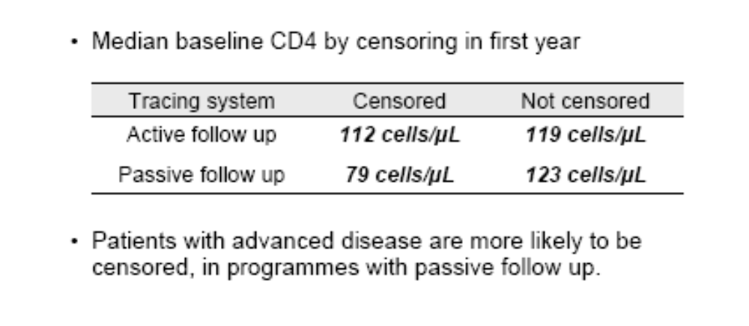
Detecting informative censoring
Impossible to fully check this assumption
  studying baselines may give some indication
    ART-Linc:

Slide 13
Remedies for informative censoring
Minimize amount of missing data
  active follow-up of all patients
    small study with good follow-up is often better than large study with many patients "lost to follow-up"
  no amount of statistical analysis can remedy missing information
  a small amount of missing data can result in large bias

Slide 14
Remedies for informative censoring
Sensitivity analysis
  Perform several analyses
    Assume non-informative censoring
      Patients that are lost to follow-up are censored at the last time they are observed.
    "Worst case scenario"
      Patients that are lost to follow-up died immediately/ some time after the last time they are observed.
    "Best case scenario".
      Patients that are lost to follow-up are cured. They are assumed to be alive at the end of the study.
  Report results of the different analyses

Slide 15
Interval censoring
Event occurred during a certain period
  unknown exactly when
  common: assessment of treatment failure by (blood) sampling, medical imaging, ...
  common analysis: analyse time to diagnosis
    OK if period is short relative to time to event
    otherwise:
      overestimation of time to event
      possible bias of treatment effect

Slide 16
Remedies for interval censoring
Increase visit frequency
Statistical analysis
  Complex analysis methods
    "Turnbull" estimator
    Parametric survival analysis
  Sensitivity analysis (different scenarios)
    Best case: event occurs at the end of the interval
    Worst case: event occurs at the start of the interval
    Midpoint: event occurs at the middle of the interval

Slide 17
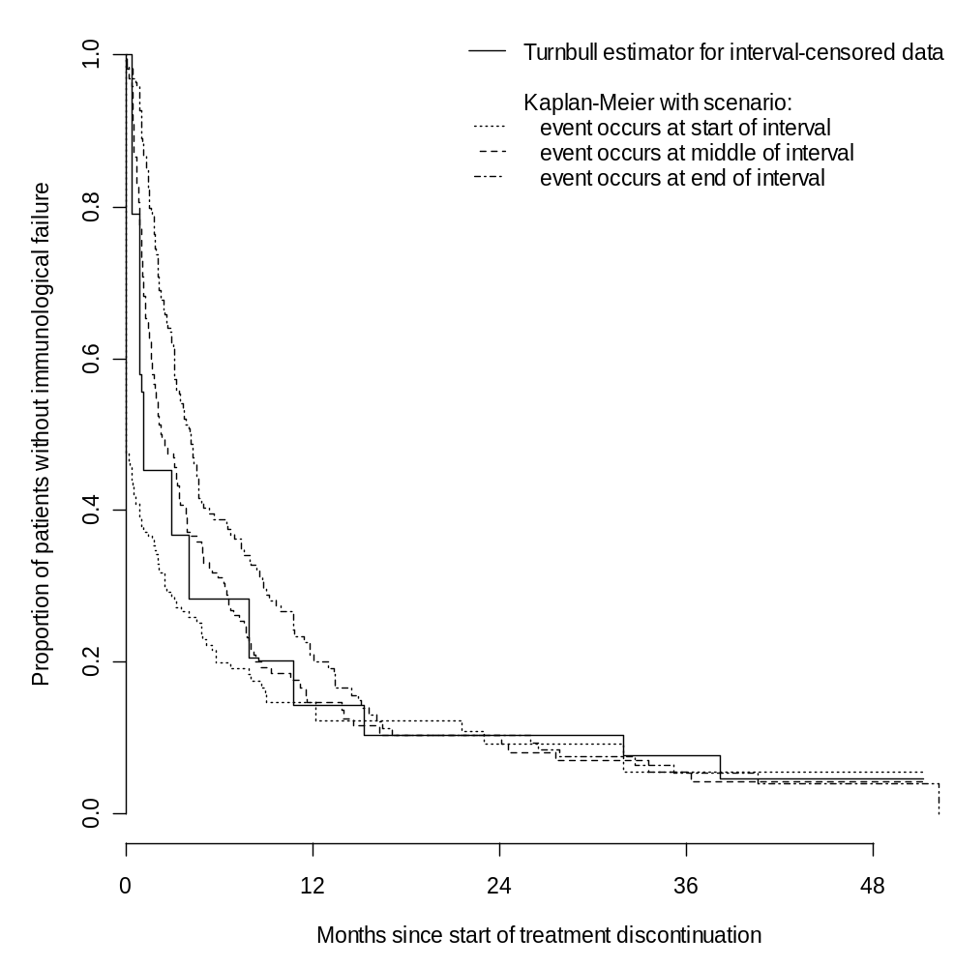
Time to immunological failure
in patients that stopped ARV
on an undetectable viral load

Slide 18
Sample size for survival studies
What do we typically need for a sample size calculation:
  significance level (5%)
    probability of significant result, if there is no true treatment difference
  power (≥80%)
    probability of significant result, if there truly is a treatment difference
  treatment difference we want to detect
    for a survival analysis: expressed as a hazard ratio
  allocation ratio (usually 1/1)
    # of patients in control group / # of patients in test group

Slide 19
Sample size for survival studies
What do we need extra for survival type data?
  baseline hazard
    expressed as median survival time or
    baseline hazard estimate
    (remember: median survival time = 0.7 / hazard)
  follow-up duration
    total follow-up depends on:
      recruitment period ("accrual time")
      additional follow-up period after end of recruitment
⇒ sample size
  number of patients to recruit
  number of events to observe

Slide 20
Sample size for survival studies
Sample size program:
"PS Power and Sample Size Calculations"
by William D. Dupont and Walton D. Plummer
Download from:
https://biostat.app.vumc.org/wiki/Main/PowerSampleSize

Slide 21
Example
Example:
You see in a publication survival curves for patients that started ARVs on WHO stage 3 (n=644) and WHO stage 4 (n=332).
You have a similar patient population and want to show a difference in survival between WHO-stage 3 and WHO-stage 4 patients. The minimum effect you want to be able to detect is a hazard ratio of 2 (hazard in WHO stage 4 / hazard in WHO stage 3). Given that the hazard appears to diminish after 1 year, we are limiting the maximal follow-up to 1 year. You want to recruit the study in 3 months.

Slide 22
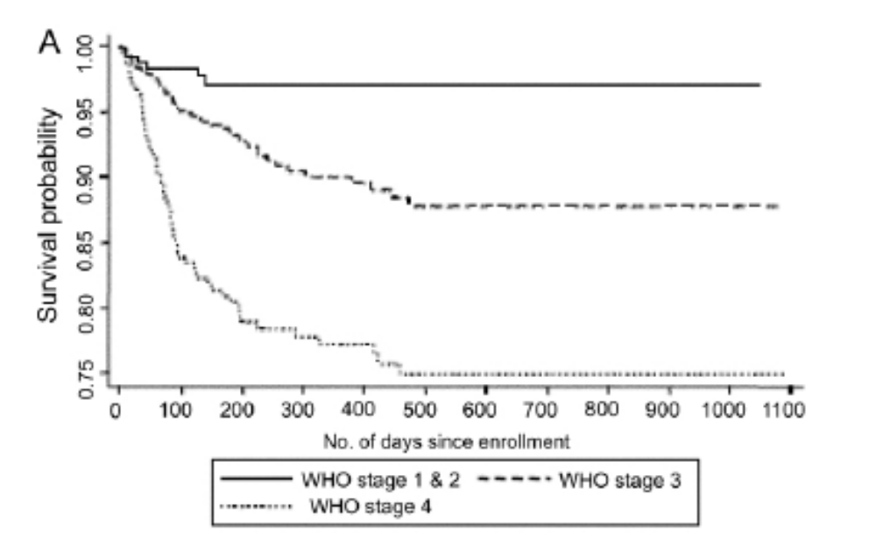

Slide 23
Alpha = 0.05
Power = 0.8
R = hazard ratio = 0.5.
m1 = median survival time on control
  approximation: median survival time = 0.7 / risk
    WHO stage 3: the mortality risk is 10%/year
    median survival = 0.7/0.1 = 7 years
A = 0.25 year
F = 0.75 year
m = ratio of control (stage 3) to experimental patients (stage 4) = 644/332 = approx 2
PS results: 225 patients in WHO stage 4 + 450 in WHO stage 3

Slide 24
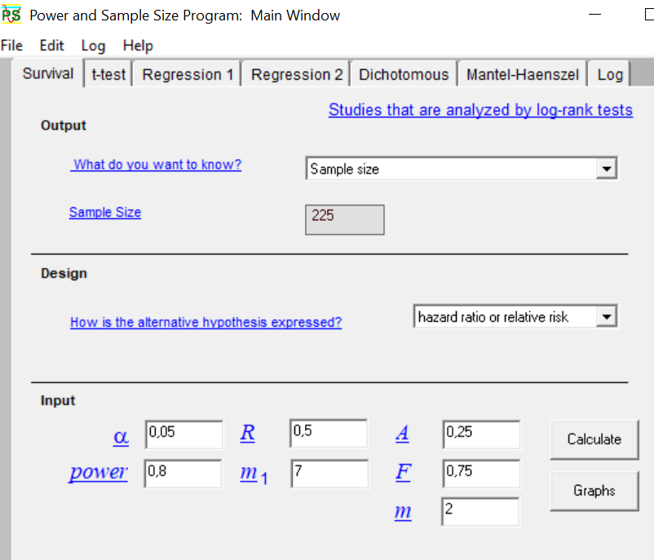

Slide 25
Output
“We are planning a study with 2 controls per experimental subject, an accrual interval of 0,25 time units, and additional follow-up after the accrual interval of 0,75 time units. In a previous study the median survival time on the control treatment was 7 time units. If the true hazard ratio (relative risk) of control subjects relative to experimental subjects is 0,5, we will need to study 225 experimental subjects and 450 control subjects to be able to reject the null hypothesis that the experimental and control survival curves are equal with probability (power) ,800. The Type I error probability associated with this test of this null hypothesis is 0,05.”

